Slide 1
A brief introduction of soft skills we have developed co-working
We decided to create an online repository on GitHub in order to have a remote copy of our working folder. Then, thanks to a proper software (Git) we have started to push our results, update them and retrieve our colleague work. (For further details: https://github.com/simonelucchesi/Corporate-project-)
Even thanks to this practice we have improved our capability of co-working, speaking through Skype (sharing our screens).
Most of analytics was developed on Jupiter Notebooks (Python programming), we found it very useful for making data analytics. (For further details: see Notebooks section)
We have improved our Excel knowledge: in fact, most of analytical results were translated into it, in order to have a better view of all our work.
Co-work notwithstanding, we also have developped a personal critical approach. In fact, forecasts were made individually.

Slide 2
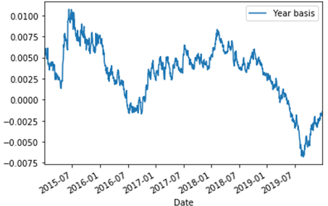
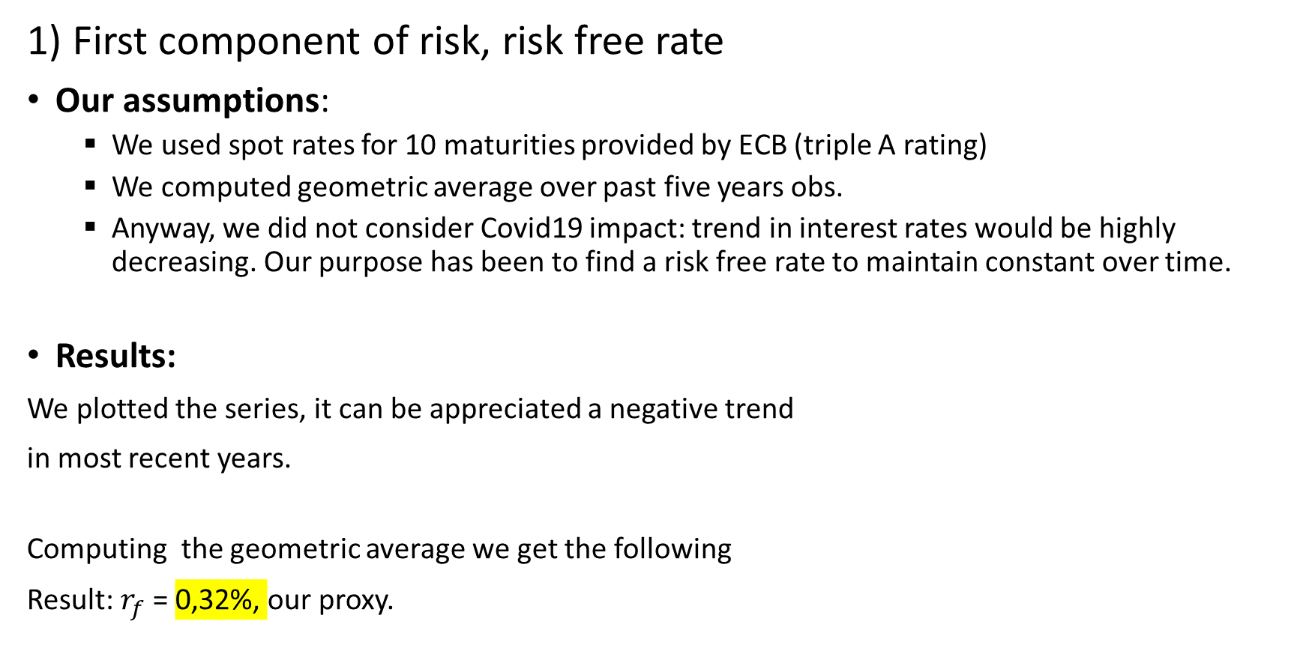
Risk fundamental analysis: our way of computing cost of equity and cost of capital for A2A.
1) First component of risk, risk free rate
Our assumptions:
We used spot rates for 10 maturities provided by ECB (triple A rating)
We computed geometric average over past five years obs.
Anyway, we did not consider Covid19 impact: trend in interest rates would be highly decreasing. Our purpose has been to find a risk free rate to maintain constant over time.
Results:
We plotted the series, it can be appreciated a negative trend
in most recent years.
Computing the geometric average we get the following
Result: $r_{f}$ = 0,32%, our proxy.

Slide 3
CAPM: market and country risk premiums
Assumptions:
Due to the fact we considered European spot rates, German stock market represents a candidate: by consistency we computed market risk premium using Dax average log return over past 5 years.
Anyway, country risk premium component must be included for Italy: we have used a rescaled CDS (starting from 170 BP) by standard deviations on Italian stock and bond markets.
In the detail we computed std of FTSE MIB 40 log returns over past 5 years; the same for an Italian BTP with time to maturity 10 years (BTP –May31).
We have decided to not include Covid-19 effect into cost of equity but to apply it differently in our forecast.

Slide 4
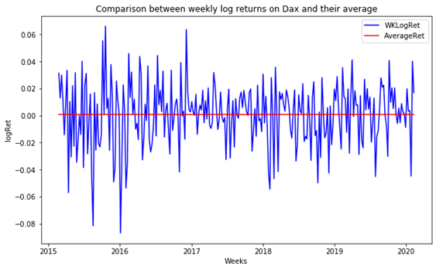
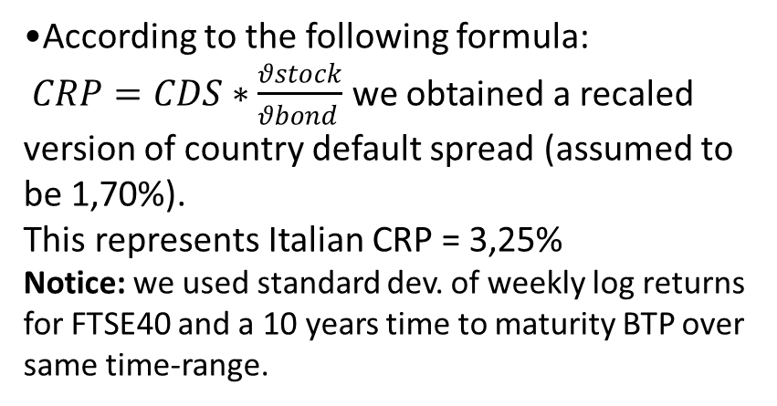
Cost of equity and cost of capital: results
•After computed geometric average of Dax weekly log returns and converted it into annual we subtracted risk free rate to obtain a proxy for stable market risk premium = 4,54%. (This according to the logic that Beta should be 1)
•According to the following formula:
$CRP=CDS∗\frac{θstock}{θbond }$ we obtained a recaled version of country default spread (assumed to be 1,70%).
This represents Italian CRP = 3,25%
Notice: we used standard dev. of weekly log returns for FTSE40 and a 10 years time to maturity BTP over same time-range.
Adding together previous results we get an equity risk premium for Italian stock market of 7,79 % .
Damodaran provides an equity risk premium of approximately 10 %, of course he used different inputs in his analysis; furthermore this result is affected by Covid outbreak.

Slide 5
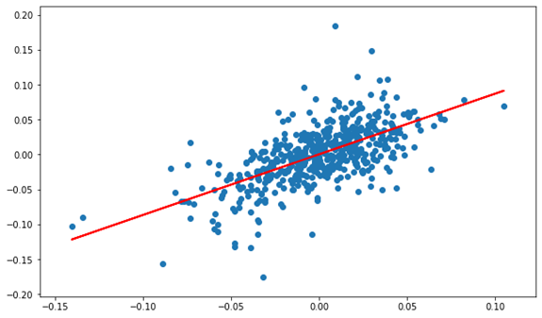
Third component: levered regression beta
For publicly traded firms it's straightforward to estimate returns an investor would have made on its equity over a given period.
This can be done by using a regression method, in our case OLS method, 1st order.
Our assumptions
Length of estimation: we have decided to use past 10 years obs (excluding Covid effect)
Return interval: due to trade off between estimation bias and lack of information we used weekly obs.
Market index proxy: we regress A2A weekly log returns against FTSEMIB40 weekly log returns.
•Results
As represented we found a positive correlation between A2A returns and FTSEMIB’s.
These are the output of regression:
Intercept = 0,0003
Slope = Regression Beta = 0,868
It’s interesting to notice that Reuters provided a Beta of 0,89. Regressing against EuroStox50 we got a beta of 0,867.

Slide 6
What about bottom-up Beta?
Workaround and assumptions
According to its latest disclosures A2A operates in several Business Units. Anyway, most of its results come from Generation & Trading, Market, Waste and Networks which refer to energy, water, heat distribution and waste allocation.
We used sector averages for unlevered betas adjusted for cash from Damodaran’s dataset. Another big assumption was to consider only 4 main industries where A2A operates in: Renewable energies, waste, gas distribution and water distribution.
We took a total of 5 unlevered betas.
Strict assumptions were also made about revenues sector allocation:
25 % of all energy from renewable production.
Waste revenues to waste sector.
Revenues from market, trading and networks to remaining sectors.
We used market debt to equity ratio: this because allows us to reduce bottom up beta towards regression beta we have computed.
Result
Resulting bottom up beta is 0,83 using market values (0,95 using book values)
This only to say that given information disclosed from A2A it’s impossible to compute an unbiased fundamental levered beta. All strict assumptions were made in order to align it to previous result.

Slide 7
Cost of equity and cost of capital, analytical approach results
(Net) Cost of debt:
Using Risk Free Rate and a default spread (from Damodaran data set)
Using A2A Debt composition, trying to obtain a proper weighted average cost of debt. This approach is most appreciated because allows us to align our result to purpose of cost reduction .
Net cost of debt: we have used a marginal tax rate of 27,9%.
For what about equity to capital and debt to capital ratios we have computed both types: book-value and market-value ratios.
Bond class | Yield to maturity | Residual Coupons | Outstanding bonds
Bond 2021 (partial) | 0,04375 | 2 | 351,457
Bond2022 | 0,03688 | 3 | 500
Bond2023 private | 0,04057 | 4 | 300
Bond2024 private | 0,01284 | 5 | 300
Bond2025 | 0,01836 | 6 | 300
bond2027 | 0,01768 | 8 | 300
bond2029 | 0,0139 | 10 | 400
Average Cost of debt | 2,17583%
Capital ratios | At 31/12/19 | Current value (At 01/04)
Equity to capital (bv) | 0,502754062 | 0,509174935
Debt to capital (bv) | 0,497245938 | 0,490825065
Equity to capital (mv) | 0,567511521 | 0,481225584
Debt to capital (mv) | 0,432488479 | 0,518774416

Slide 8
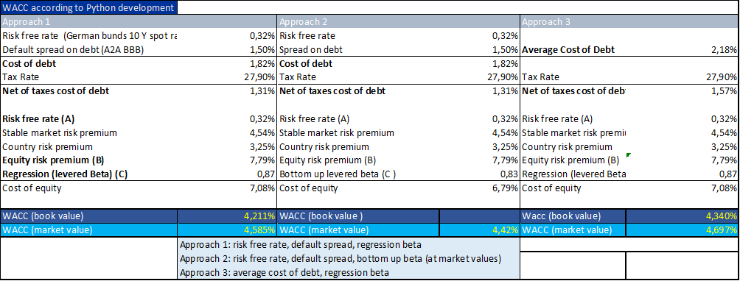
Final results (analytical approach)
Approach n° 3 is the best suited for our purposes: it allows for an updated cost of debt.
Notice: In its debt report A2A declares an average cost of debt of 2.8%, this depends by some of its foreign issues which are not considered in our computation (a small slice of the «pie»).

